Slide 1





Individual Assignment
Mobile Technology and Development
Nurul Izzah Binti Burhan
2023503023

Slide 2


Output Apps

Slide 3
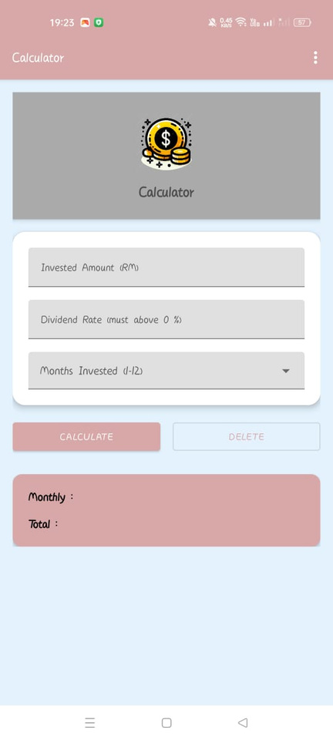
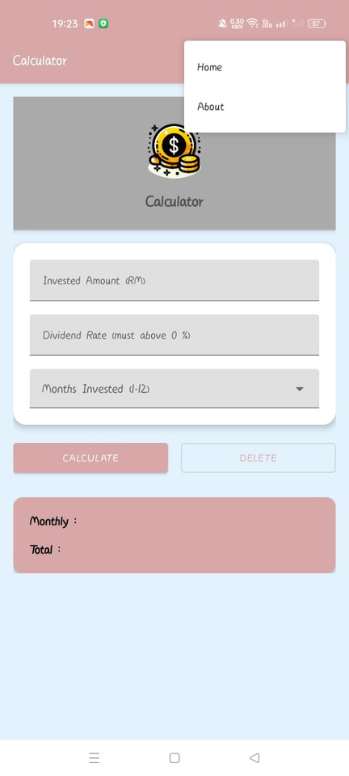
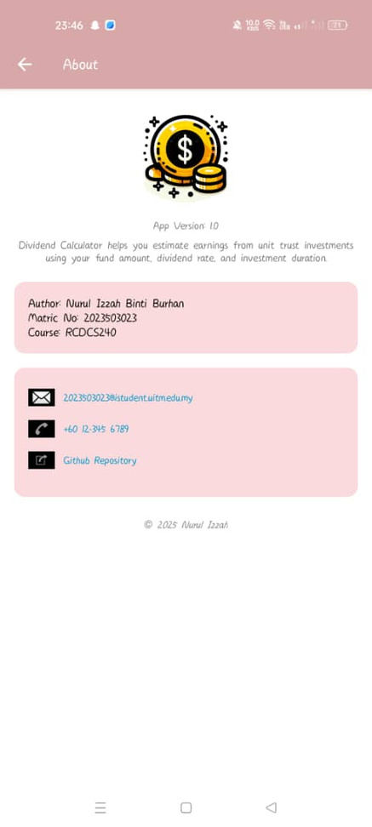
Light Mode

Slide 4
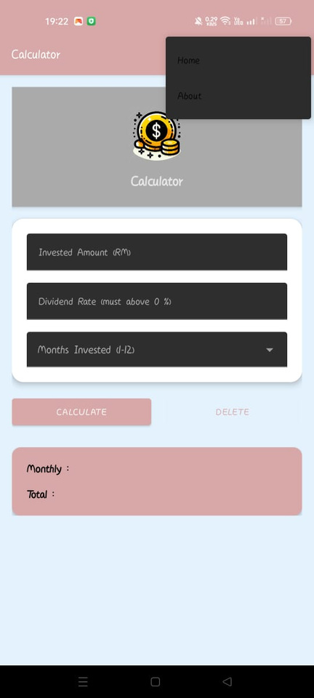
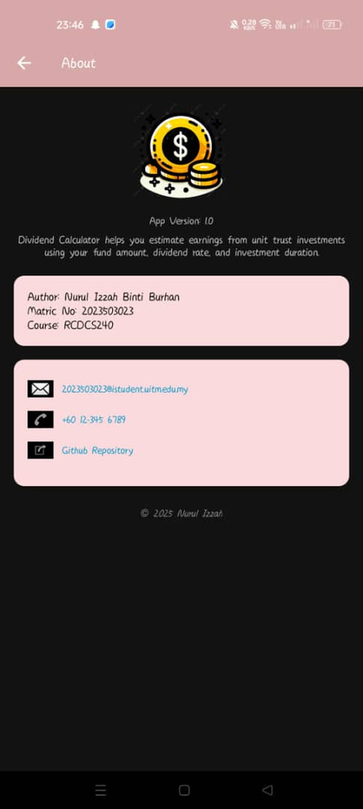
Dark Mode

Slide 5
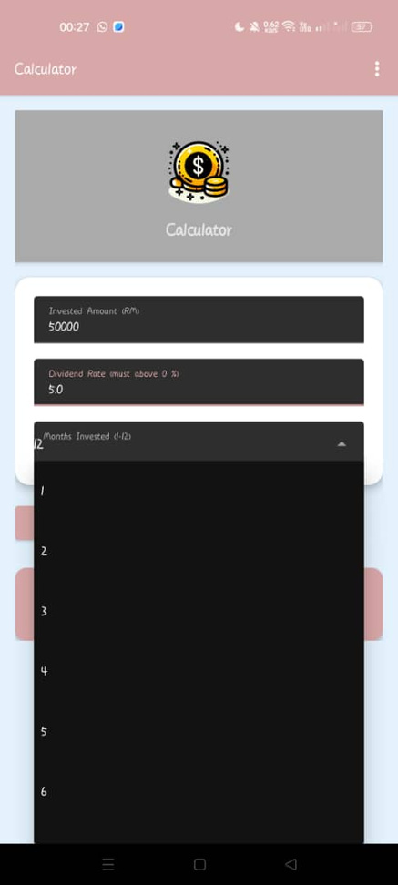
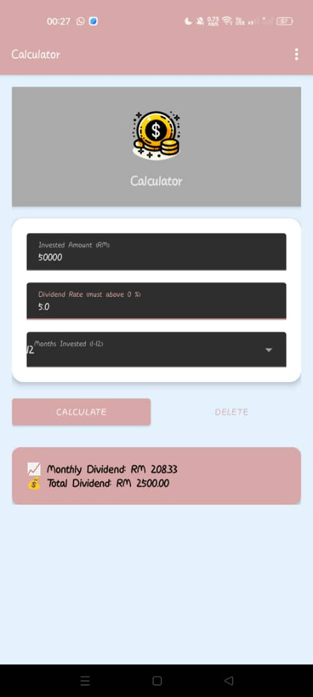
Example Output

Slide 6


Thank You

